Slide 1
Playlist Generation
By: Marco Pezzolla & Alex DeGeorge

Slide 2
Introduction
Music streaming services pay attention to all different ways you interact with their software.
Artists, genres, geographical location, and even time listening are all taken into account to build a profile on you the listener.
The service then takes this information, evaluates it, and makes predictions to increase a user’s satisfaction and interaction level with the service.
Such a way is through generating playlists users may find enjoyable

Slide 3
Example: Spotify Wrapped
As many of you may know, Spotify has their “Spotify Wrapped”, which is a year in review unique to each and every user.
It evaluates a user’s most played songs, favorite artists, favorite genres, and even creates a user’s unique “Audio Aure” based on the music they listen to.

Slide 4
Why Listen In?
Whilst some may find things like this an invasion of privacy, it is also an interesting and complex phenomenon.
So what is the point of creating playlists of songs a user already knows and loves?
With so many music services, it is important to try to keep informed on what someone enjoys listening to while also trying to create new experiences for them.
Music platforms use machine learning to dictate what plays together on shuffle, relying on metadata and other digital information to play songs related to one another (Cardinali, 2021).
A song could be coded as "happy" if it met a minimum combination of number of beats per minute and in a specific key signature. Machine learning would use these parameters to group "happy" songs together based on how much of the criteria the song met, then create a playlist or radio station using songs within the parameters (Cardinali, 2021).
Music services may make playlists with a collection of high beat songs that may be titled something along the lines of “Workout Jams” or “My Morning Drive”.

Slide 5
Our Approach
After doing research, we found a data set containing the top songs from the last decade titled: “Analysis from 2010-2019 Spotify”.
Data will be shown later.
We would use the songs as our inputs, but more specifically, ‘bpm’ (beats per minute), ‘nrgy’ (energy), and ‘dur’ (duration) would be our features to dive into.
This will allow for the classification of the songs based on inherent features of the music and will result in the generation of a playlist.
Our output, would be a carefully crafted playlist made up of a combination of top songs from the last 9 years, based on similarities amongst them all when focusing on those three features.
The algorithms to conduct this project will be “K-Means”, “KNN”, “SVM” and “Random Forest”.
K-Means starts with a random set of initial center where each data point is assigned to its closest center and each center is repeatedly recomputed until each data point converges to a fixed cluster (Lin & Jayarathna, 2018).
By using these algorithms, it will provide a classification method for identifying and dividing the genres of music most preferred by the majority of users.
This will result in the assembly of the generated playlist using machine learning algorithms and will be evaluated through statistical analyses of the user’s musical preferences.

Slide 6
Past Research & Procedure - 2018 IEEE International Conference
Our first bit of prior research comes from the “2018 IEEE International Conference on Information Reuse and Integration for Data Science”.
This study used K-Means Clustering, Affinity Propagation, and DBSCAN Clustering.
The researchers in this project also incorporated clustering algorithms and musical analysis tools using the open-source tool “Organize Your Music”.
This allowed for large scale analysis and quantization of subjective audio features into integers or float values for audio tracks (Lin & Jayarathna, 2018).

Slide 7
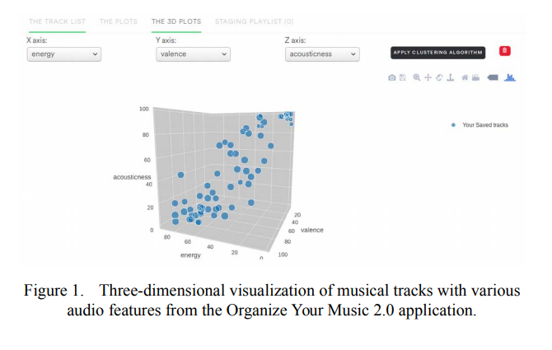
Past Research & Procedure - 2018 IEEE International Conference
The following figure shows the visualization of audio features in three-dimensional Euclidean space.
By using Euclidean space, a collection of points may be characterized by its average (Lin & Jayarathna, 2018).
A user can then select which of the features to create a playlist based on and have the cluster compile the song list.
(Lin & Jayarathna, 2018).

Slide 8
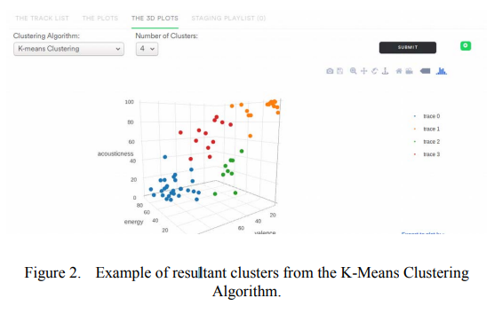
Past Research & Procedure - 2018 IEEE International Conference
This figure shows the outputs of K-Means clustering when applied to the sample dataset.
Clustering is based on the audio features provided by the Spotify Developer Web API.
User is allowed to specify the number of clusters within the algorithm to produce.
(Lin & Jayarathna, 2018).

Slide 9
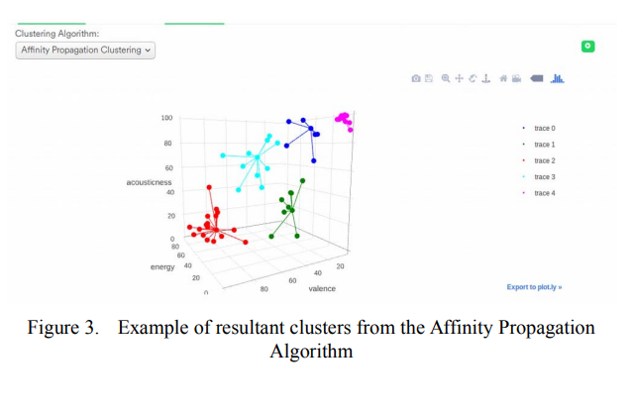
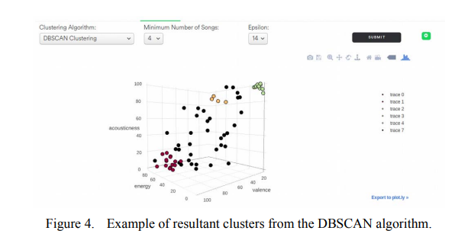
Past Research & Procedure - 2018 IEEE International Conference Concluding Results
Users in this study found the machine learning to be beneficial and accurate.
DBSCAN had potential to show the best results, but had shortcomings such as that the tuning of the epsilon and minimum samples parameter may prove to be difficult for less technical users.
Further development is needed to increase accuracy and increase Artificial Intelligence.
Future work may include the use of alternative machine learning algorithms that work more as clustering algorithms rather than partitioning algorithms (Lin & Jayarathna, 2018).
(Lin & Jayarathna, 2018).
(Lin & Jayarathna, 2018).

Slide 10
Past Research #2 - ACADEMIA
Other attempts to generate a music playlist was conducted by Academia and published in their paper titled: “Generating Music Playlists with Hierarchical Clustering and Q-Learning”.
Information regarding the audio files (songs) were first extracted by dividing the 16KHz signal into windows of 512 samples and extract 14 features using the jAudio library.
Features were: spectral centroid, spectral roll-off, spectral flux, compactness, spectral variability, root mean square of the power, fraction of low energy windows, zero crossings rate, strongest beat, beat sum, strength of the strongest beat, Mel-Frequency Cepstrum Coefficients (MFCC), Linear Predictive Coding (LPC) and the statistical method of moments.

Slide 11
Past Research #2 - ACADEMIA
The researchers chose to use hierarchical clusters, in which a tree of clusters is constructed using K-Means clustering, and Q-learning.
Q-learning is a model-free reinforcement learning technique which learns a Q-function that gives the expected utility of taking a particular action a. (King & Imbrasaitė, 2015).
The team would create their own music player that would assign values based on how users interacted with the songs presented to them
When a track plays all the way through without interruption from the user, a positive reward to it from the prior track is established with a reward of r = 1.0.
The earlier a track is skipped, the greater the negative weight on the reward assigned, r = −1.0.
The study would involve recruiting 20 participants which are separated into two groups: the control group (5 participants) and the experimental group (15 participants).
Each participant was to use the music player for 28 days.

Slide 12
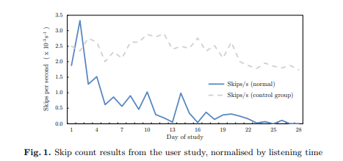
Past Research #2 - ACADEMIA
The player had 3 modes: manual playlist creation, shuffle mode and the Smart Playlist mode
For the control group, the Smart Playlist’s behaviour was identical to shuffle mode. The participants were not aware of which group they belonged to.
(King & Imbrasaitė, 2015)

Slide 13
ACADEMIA - Concluding Results
The playlist generator artificially devised a library with 3 clusters corresponding to 3 different genres.
This was to test learning capabilities.
Most users had libraries of 100–1000 songs, which aligns well with the cluster size being used (K=6).
Overall results found users using the Smart Play mode with participants beings pleased with the player’s utility in rediscovering old music.
The playlist generator is suited for large libraries as the use of hierarchical clustering enables it to scale extremely well, while still being able to learn user’s preferences.
Future research would be needed for the following extension:
Choosing songs by considering the feature difference between the end of one song and start of the next one.

Slide 14
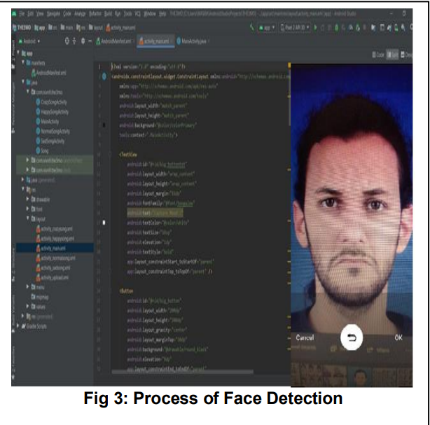
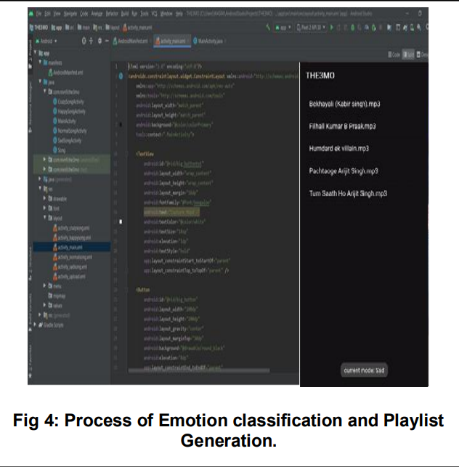
Other Research #1
With the constant increasing popularity of music streaming, it is no surprise numerous tests and reports have been generated around trying to find the best playlist generator with a multitude of factors influencing results.
Other research is included below.
The “International Journal of Engineering Applied Sciences and Technology” attempted to create music playlists based off of a user’s emotions.
Uses CNN (Convolutional Neural Network)
The facial expressions are broadly categorized into 5 categories such as Anger, Joy, Surprise, Sad and Excitement.
There were three phases to retrieving the emotion of a user, Face Detection - using RGB Color modelling, Feature Extraction - using the Active Appearance Model Method, and Expression Recognition - Analyze the face area and verify facial emotion characteristics.
Succeeded in providing preferable playlists. Further focus can be on adding more features such as age and weather (Yadav & Kharat, n.d.).
Yadav & Kharat, n.d.
Yadav & Kharat, n.d.

Slide 15
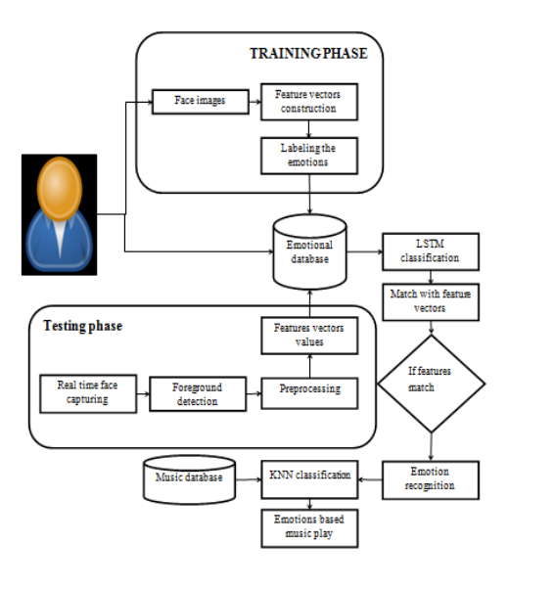
Other Research #2
Saravanan, et al., n.d.
“International Journal of Computer Techniques”
Uses KNN and LSTM (Long Short Term Memory) classifier.
Uploads a face as a 2D image, and performs the preprocessing steps such as gray scale conversion, invert, and border analysis, detecting edges and region identification (Saravanan, et al., n.d.).
Implement HAAR cascades to detect facial features and ignores anything else, such as buildings, trees and bodies.
Then classifies emotions based on expressions using LSTM classifier.
KNN is used to classify music based on emotions presented (Saravanan, et al., n.d.).
The experimental results on both databases showed that the proposed method achieves competitive recognition performance compared with the state of the art methods under same experimental settings and same facial feature (Saravanan, et al., n.d.).

Slide 16
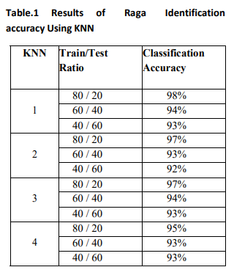
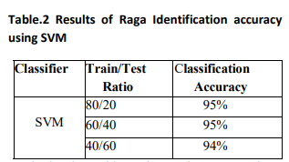
Other Research #3
“ Indian Classical Raga Identification using Machine Learning”
Uses K Nearest Neighbor and Support Vector Machine
Focuses on extracting Power Spectrogram, Mel-Frequency Cepstral Coefficients, Spectral Centroid, Zero-Crossing Rate, Roll-Off Frequency, and Spectral Bandwidth.
Successful in their efforts and future focus can include expanding the dataset with other Ragas for acquiring more accurate results and implementing other classifier for detecting ragas (Joshi et al., 2021).
Joshi et al., 2021
Joshi et al., 2021

Slide 17
What Worked Best?
“International Journal of Engineering Applied Sciences and Technology” we found to be the most advanced and technically impressive.
This was due to its CNN approach in addition to using Face Detection, Feature Extractions, and Expression Recognition.
“International Journal of Computer Techniques” and “2018 IEEE International Conference on Information Reuse and Integration for Data Science” we found to be very similar to our approach.
Mostly in part to their inclusion of KNN and K-Means.

Slide 18
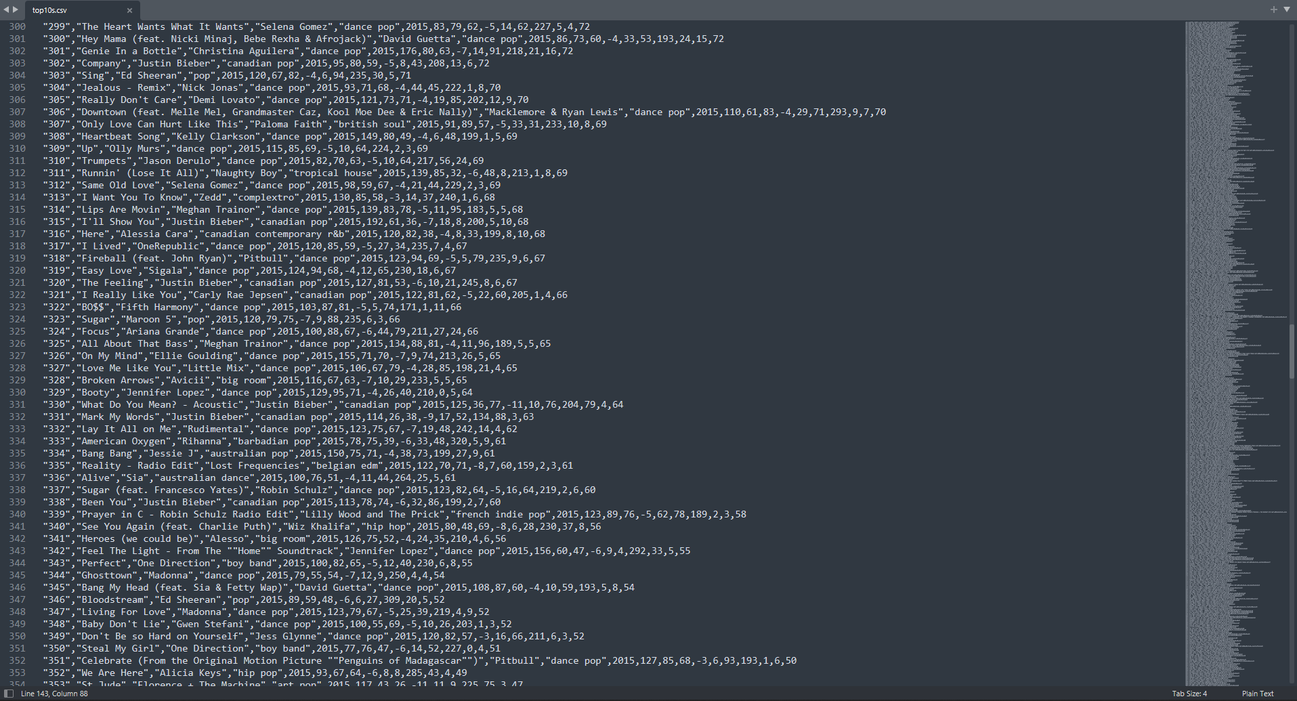
A Look Into Our Data
https://www.kaggle.com/leonardodata/analysis-from-2010-2019-spotify/data
Features: "title","artist","top genre","year","bpm","nrgy","dnce","dB","live","val","dur","acous","spch","pop"

Slide 19
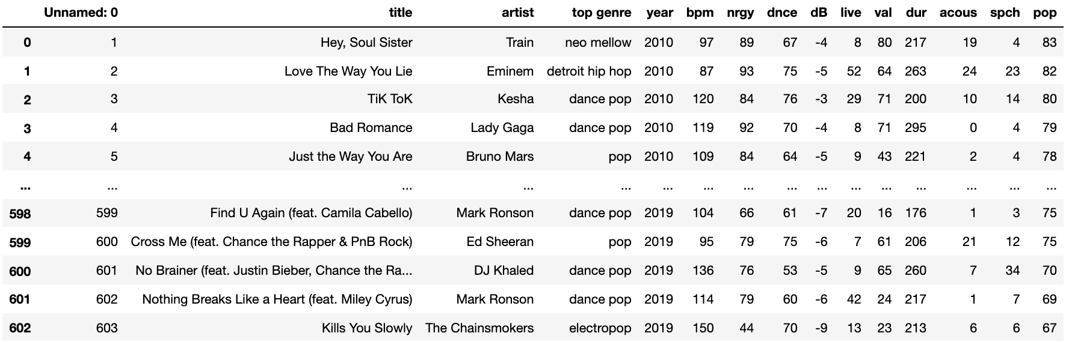
Libraries Used
Numpy
Pandas
Scikit-learn
Matplotlib
mpl_toolkits

Slide 20
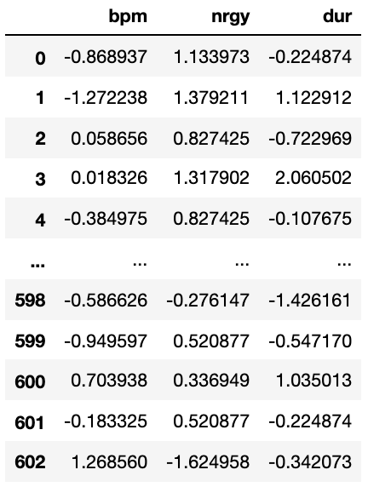
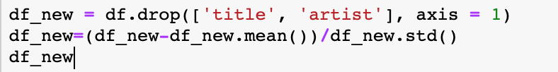
Pre-Processing
Select our features
Standardize the data

Slide 21
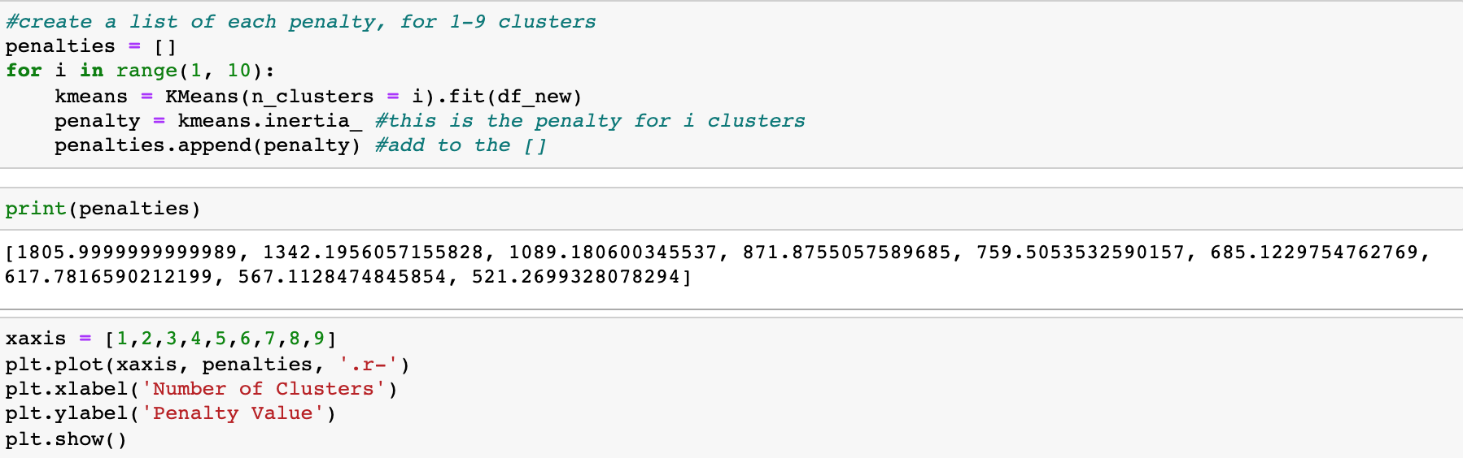
KMeans Source Code

Slide 22
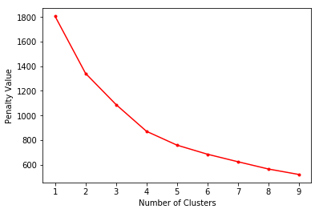
KMeans: For Classification
Unsupervised learning
No labels
No images
Needed to know how many clusters/playlists to make
Elbow Method
Chose 4 clusters

Slide 23
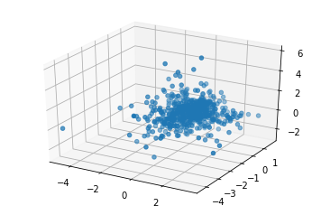
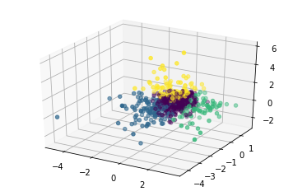
KMeans Clustering

Slide 24
Prediction Models
KMeans provided “actual” labels
Prediction models:
KNN
Random Forest Classifier
Support Vector Machine
Train-test split
400 train
200 test

Slide 25
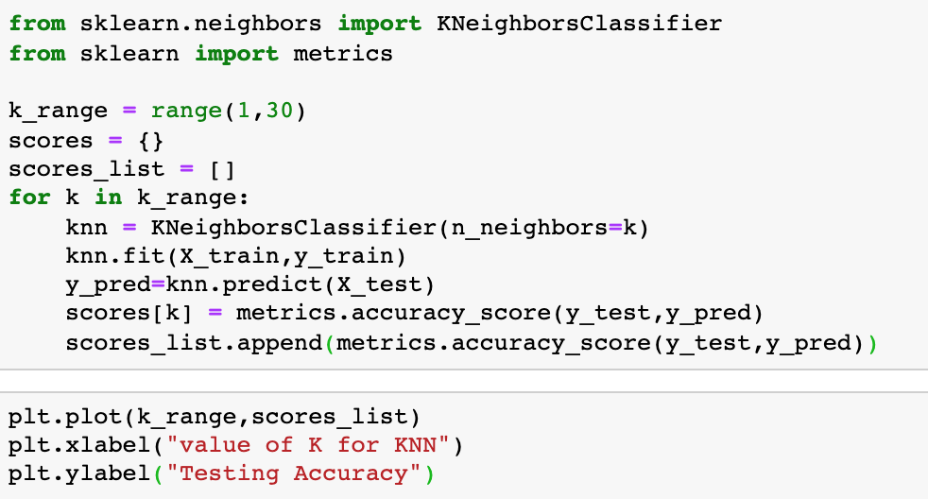
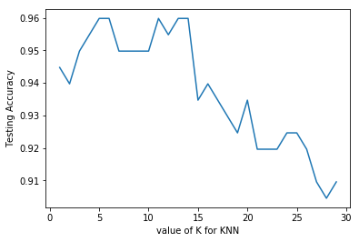
KNN Source Code

Slide 26
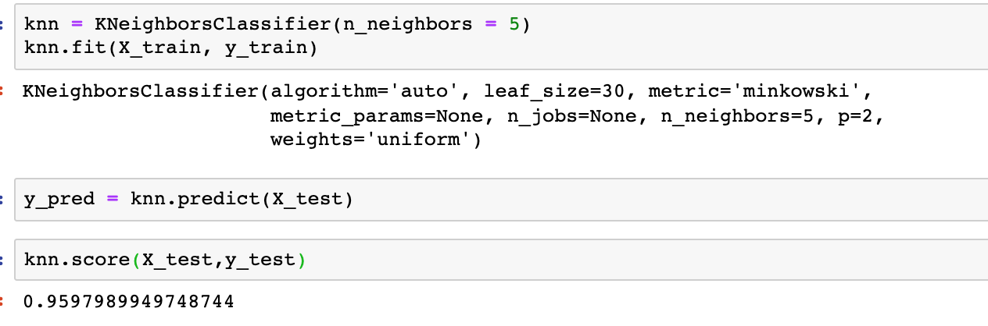
Evaluation

Slide 27
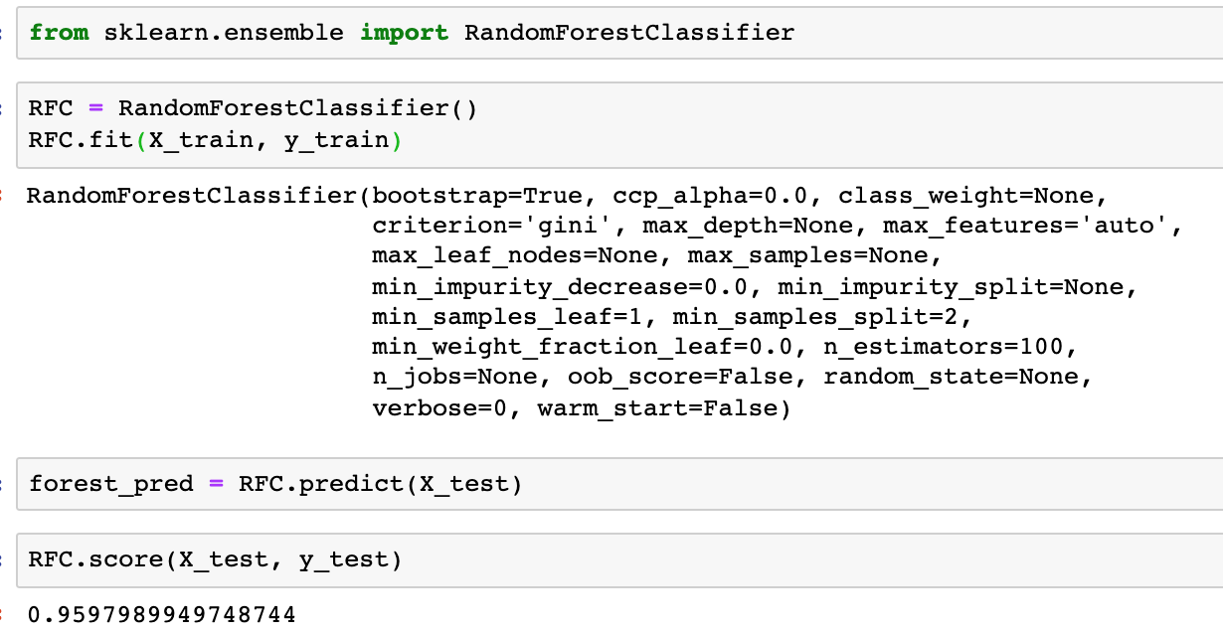
Random Forest Classifier

Slide 28
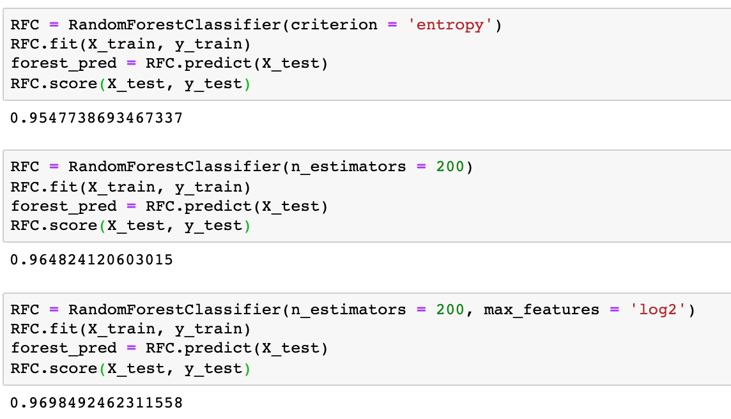
Parameter Tuning

Slide 29
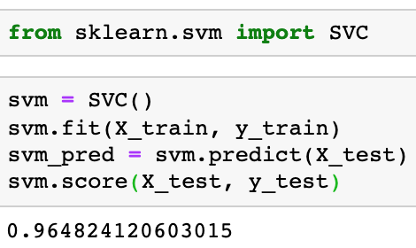
Support Vector Machine

Slide 30
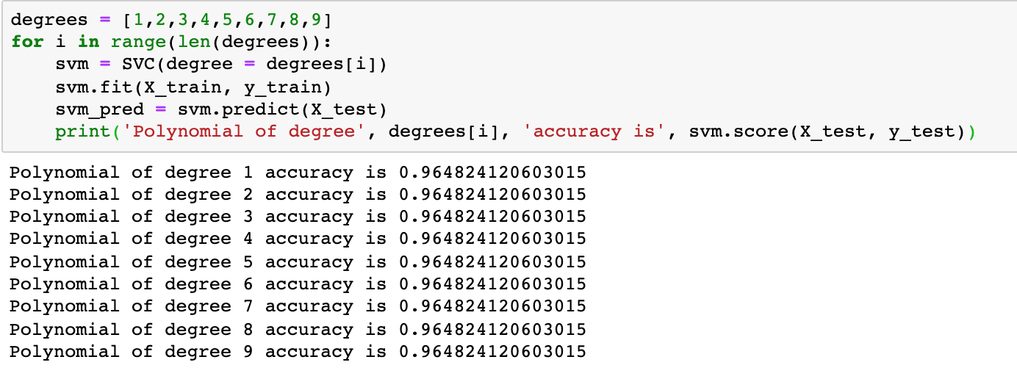
Parameter Tuning (1)

Slide 31
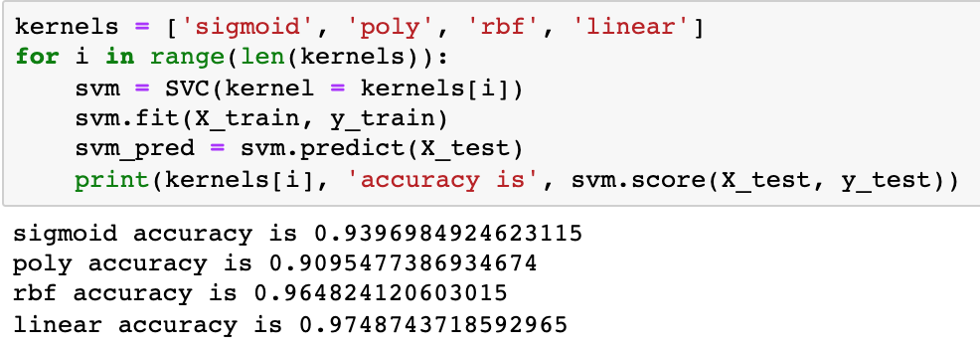
Parameter Tuning (2)

Slide 32
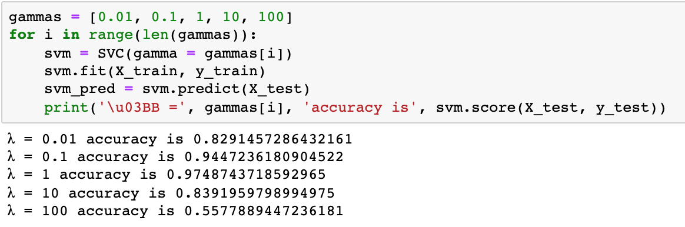
Parameter Tuning (3)

Slide 33
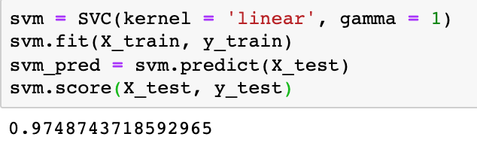
Final Decision

Slide 34
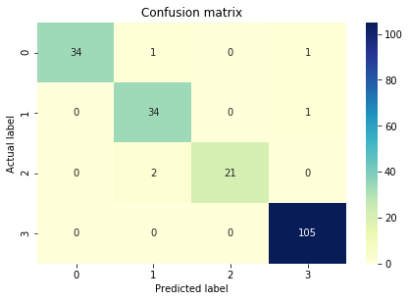
Confusion Matrix

Slide 35
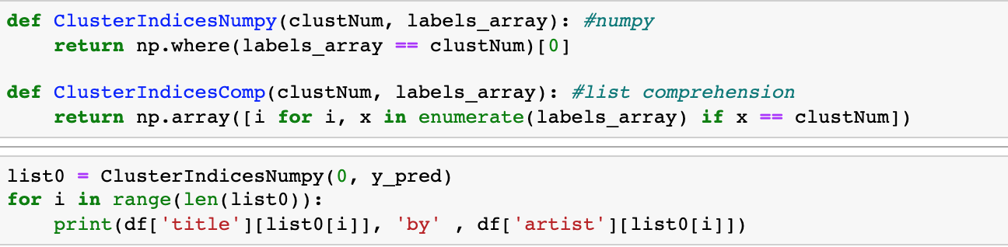
Playlist Generation Code

Slide 36
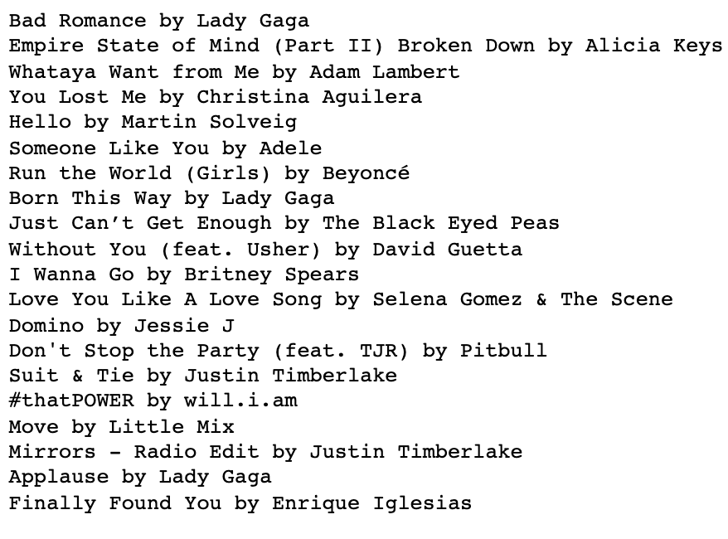
Playlist Generation

Slide 37
Compare & Contrast
Compared to the research we evaluated earlier, our approach was similar in regards to our learning algorithm of choice (KNN and KMeans).
It seemed a majority of research both included and not included in this report relied on KNN.
They differ from our approach in a few key ways:
The features focused on
The use of facial recognition
SVM

Slide 38
Conclusion
Best algorithm: SVM with hyperparameter tunings
Boundary based algorithm
Implications: new method for playlist generation
Future work: testing more variables
3 variables selected for visual aid, might get different results with all or different variables

Slide 39
References
Cardinali, E. (2021, November 30). 'tis the season for wrapped playlists - how much did AI affect your listening?
UNIVERSITY of FLORIDA News. Retrieved from https://news.ufl.edu/2021/11/end-of-year-playlists-ai/.
De Jesus Silva, L. (2020, February 22). Analysis from 2010-2019 Spotify. Kaggle. Retrieved from
https://www.kaggle.com/leonardodata/analysis-from-2010-2019-spotify/data.
Joshi, D., Pareek, J., & Ambatkar, P. (2021). Indian Classical Raga Identification using Machine Learning.
Retrieved from http://ceur-ws.org/Vol-2786/Paper34.pdf
King, J., & Imbrasaitė, V. (2015, March). Generating music playlists with hierarchical clustering and Q-learning. In
European Conference on Information Retrieval (pp. 315-326). Springer, Cham. Retrieved from https://d1wqtxts1xzle7.cloudfront.net/37437381/playlist-with-cover-page-v2.pdf?Expires=1639238168&Signature=Ob9noHLEFavx0-yik1dm-GvHvqVVqqUm83Q6lHD0TDDsup63rG~zP1g5hVcoq7SgfcOzVRlkxeVKMBVER~OFrF5WdWTYF54PG~qXlX4JE~Bm8h-y0cyPlBlYlmIz17arP~eEyDYlPloq4iYFJeAwEpXlmKzvk3kAMAy-lmwHYyrcEcqyzEEMXEkVVJhPkZxF7v2Mam0cHOSkV1IXezuhJT2cCudn~7gUYjh-X~Mxch28HF~z9WAs0SwmMpMnrfENTp2naycVrtp-M6CciK9c5-to1jqHfQ3ISIA7GyA1i-YP1BCZw7e3T2sf6utNX5AKd10RWNrqlE60-hxw8YQ8qw__&Key-Pair-Id=APKAJLOHF5GGSLRBV4ZA

Slide 40
Lin, D., & Jayarathna, S. (2018, July). Automated Playlist Generation from Personal Music Libraries. In 2018 IEEE
International Conference on Information Reuse and Integration (IRI) (pp. 217-224). IEEE. Retrieved from https://www.cs.odu.edu/~sampath/publications/conferences/iri2018_11.pdf
Saravanan, M., Kowsalya, M., Kanimozhi, T., Vaitheeswari, B., & Kanmani, T. Facial Expression Recognition Based on Deep Learning Algorithm for Annotated the
Music in Player. Retrieved from http://www.ijctjournal.org/volume8/issue2/ijct-v8i2p44.pdf
user77005user77005 1, PraveenPraveen 1, KevinKevin 6, gonidelisgonidelis 65788 silver badges2727 bronze badges, seraloukseralouk 25.3k55 gold badges9090 silver badges109109 bronze badges, FarseerFarseer 3, & Sandeep ShahiSandeep Shahi 3355 bronze badges. (1964, April 1).
How to get the samples in each cluster? Stack Overflow. Retrieved from https://stackoverflow.com/questions/36195457/how-to-get-the-samples-in-each-cluster
Yadav, M. U., & Kharat, M. S. PERSUASIVE TECHNOLOGY TO GENERATE SONGS PLAYLIST USING EMOTION BASED
MUSIC PLAYER. Retrieved from http://www.ijeast.com/papers/119-123,Tesma510,IJEAST.pdf

